Slide 1



Five benefits of mobile learning for adults by Chante Johnson

Slide 2
Introduction
Mobile learning, often referred to as m-learning, is the process of accessing educational content through mobile devices such as smartphones, tablets, and laptops.
This form of learning leverages the portability and connectivity of these devices to provide educational opportunities anytime and anywhere.
Notes:
Definition of mobile learning: Mobile learning, or mLearning, refers to the use of mobile devices such as smartphones and tablets to access educational content and engage in learning activities.
Importance of mobile learning in adult education: Mobile learning is transforming adult education by providing flexible, accessible, and personalized learning opportunities that fit into the busy lives of adult learners.

Slide 3
Five benefits of mobile learning
Flexibility and Convenience
Increased Engagement
Personalized Learning
Cost-Effectiveness
Accessibility

Slide 4

Flexibility and Convenience
Access to learning materials anytime, anywhere.
Balancing education with work, family, and other commitments.
Notes:
Access to learning materials anytime, anywhere: One of the greatest advantages of mobile learning is the ability to access educational materials at any time and from any location. This flexibility allows learners to study during their commute, lunch breaks, or any other convenient time.
Balancing education with work, family, and other commitments: Mobile learning enables adults to balance their educational pursuits with their professional and personal responsibilities. This makes it easier for them to continue their education without sacrificing other important aspects of their lives.

Slide 5

Increased Engagement
Interactive and multimedia-rich content.
Use of videos, quizzes, and gamified elements to maintain interest.
Notes:
Interactive and multimedia-rich content: Mobile learning often incorporates interactive elements such as videos, quizzes, and gamified content, which can make learning more engaging and enjoyable.
Use of videos, quizzes, and gamified elements to maintain interest: These multimedia elements help to maintain learners’ interest and motivation, making the learning process more dynamic and effective.

Slide 6
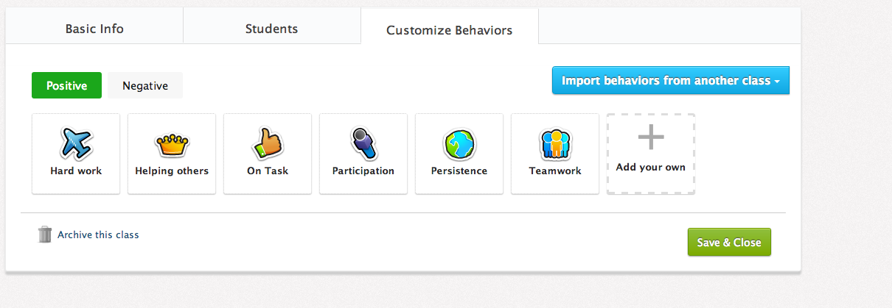
Personalized Learning
Self-paced learning opportunities.
Customization of learning paths based on individual needs.
Notes:
Self-paced learning opportunities: Mobile learning allows learners to progress at their own pace, giving them the freedom to spend more time on challenging topics and move quickly through material they find easier.
Customization of learning paths based on individual needs: Learners can customize their learning paths to focus on areas that are most relevant to their personal or professional goals, ensuring a more tailored and effective learning experience.

Slide 7
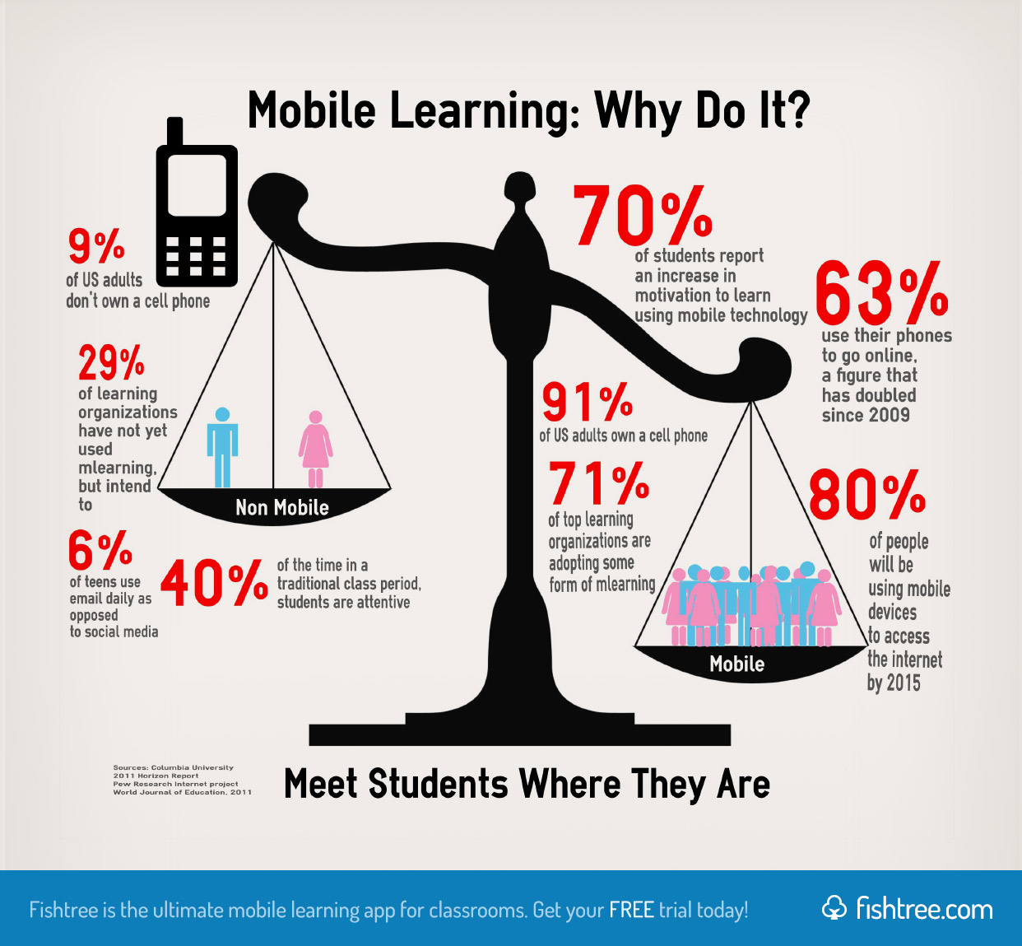
Cost-Effectiveness
Reduced need for physical materials and travel.
Availability of free or low-cost mobile learning apps and resources.
Notes:
Reduced need for physical materials and travel: Mobile learning reduces the need for physical textbooks, printed materials, and travel to educational institutions, which can significantly lower the overall cost of education.
Availability of free or low-cost mobile learning apps and resources: There are many free or affordable mobile learning apps and resources available, making education more accessible to a wider audience.

Slide 8
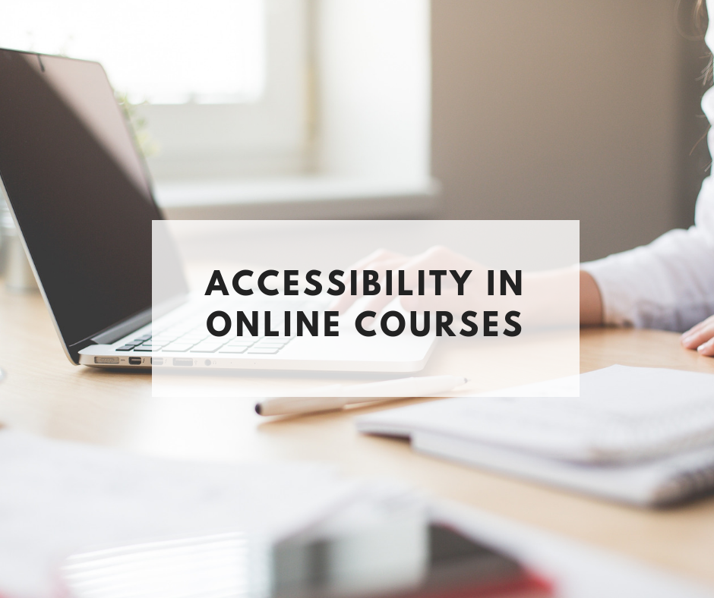
Accessibility
Reaching learners in remote or underserved areas.
Providing opportunities for lifelong learning and professional development.
Notes:
Reaching learners in remote or underserved areas: Mobile learning can reach learners in remote or underserved areas where traditional educational resources may be limited or unavailable.
Providing opportunities for lifelong learning and professional development: Mobile learning supports lifelong learning and professional development by providing continuous access to educational content and resources, helping adults to stay current in their fields and advance their careers.

Slide 9
Conclusion
We’ve explored how mobile devices are revolutionizing adult learning by providing flexibility, increased engagement, personalized learning experiences, cost effectiveness, and accessibility.
The integration of mobile technology in adult education is not just a trend but a transformative approach that empowers learners to achieve their educational goals anytime, anywhere.
I encourage you to explore mobile learning tools and consider how they can enhance your educational programs.
Notes:
Summary of key benefits: In summary, mobile learning offers flexibility, increased engagement, personalized learning, cost-effectiveness, and accessibility, making it an ideal solution for adult learners.
The growing importance of mobile learning in adult education: As technology continues to evolve, the importance of mobile learning in adult education will only grow, providing more opportunities for adults to enhance their knowledge and skills in a convenient and effective manner.

